Slide 1



INFO 7390 - ADVANCES IN DATA SCIENCE
word2vec
An Intuitive understanding and explanation of the word2vec model.
SUHAS K M
Word2vec Assignment

Slide 2
 | Word Embeddings and Word2Vec
 | 2 Approaches to word2vec
 | Results
OVERVIEW
2 Approaches to word2vec

Slide 3

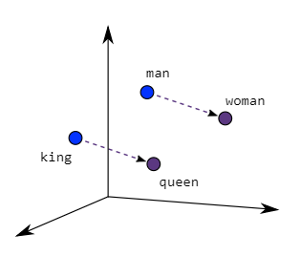
What are word Embeddings?
Word Embeddings are a method of extracting features out of text so that we can input those features into a machine-learning model to work with text data. They try to preserve syntactical and semantic information.
Word embeddings are dense, low-dimensional representations of words, while Word2Vec is a specific technique used to generate such embeddings by training a shallow neural network to predict words in context.

Slide 4
Need for Word Embedding?
Why do we need Word Embeddings?
To reduce dimensionality
To use a word to predict the words around it.
Inter-word semantics must be captured.
Take the words —-> Give their numeric representation —-> Use in training or inference.
To represent or visualize any underlying patterns of usage in the corpus that was used to train them.

Slide 5
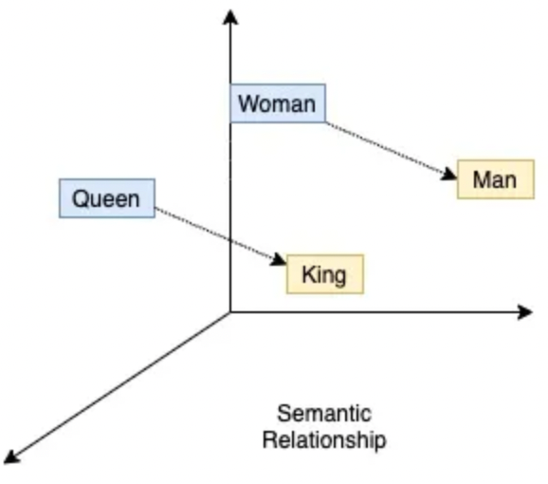
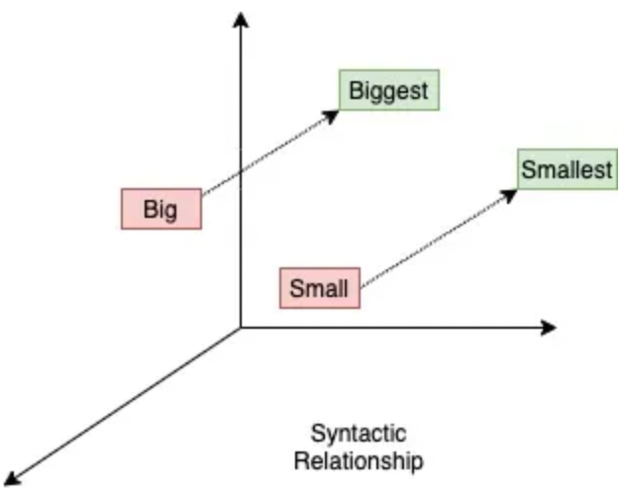
So how are these relationships formed?
Relationships in Word2Vec models are formed through vector similarity, where words with similar meanings have vectors closer in space. This similarity is learned during training as the model adjusts word vectors to predict context accurately.
By capturing semantic relationships, such as analogies or semantic similarity, Word2Vec facilitates tasks like word analogy completion and semantic similarity measurement.
In simpler words these words word2vec tries to make words with similar context to have similar embeddings
We can decide the dimension of the vector (embedding dimension). For example, if we choose the embedding dimension is 2, then the word “hello” can be presented as [0.213, 0.4543].

Slide 6
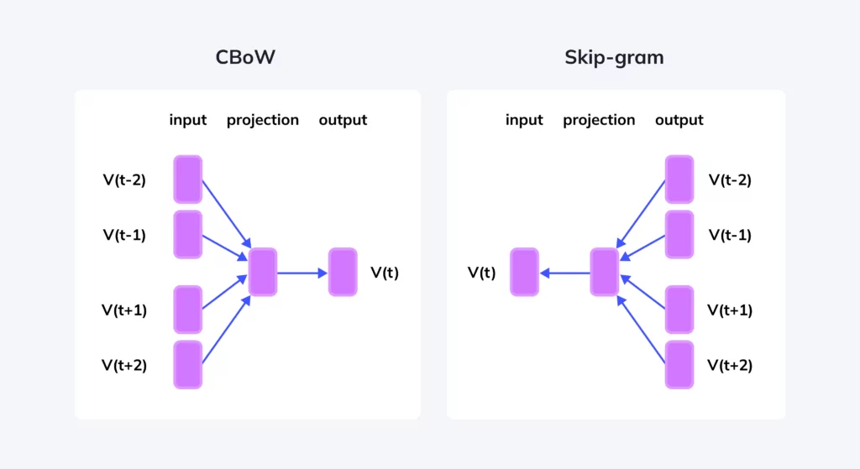
word2vec
It learns distributed representations of words by predicting words in context within a large corpus.
The resulting word vectors capture semantic relationships and are used in various NLP tasks like sentiment analysis and machine translation.
The model consists of two architectures: Continuous Bag of Words (CBOW) and Skip-gram. CBOW predicts a target word from its context, while Skip-gram predicts context words from a target word.

Slide 7

2 Approaches to word2vec

Slide 8
2 Approaches to Achieve word2vec
CBOW predicts a target word from its context, while Skip-gram predicts context words from a target word, offering complementary approaches to generating word embeddings in Word2Vec.
Word2Vec provides two distinct approaches, CBOW and Skip-gram, catering to different NLP needs. CBOW efficiently learns embeddings by predicting a target word from its context, ideal for smaller datasets. In contrast, Skip-gram excels in capturing intricate semantic relationships by predicting context words from a target, making it suitable for larger corpora. Together, these models empower NLP practitioners with versatile tools to extract meaningful representations of words from text data.

Slide 9
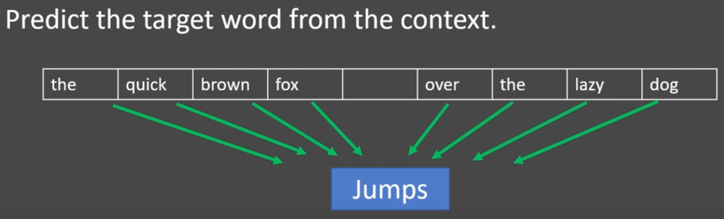
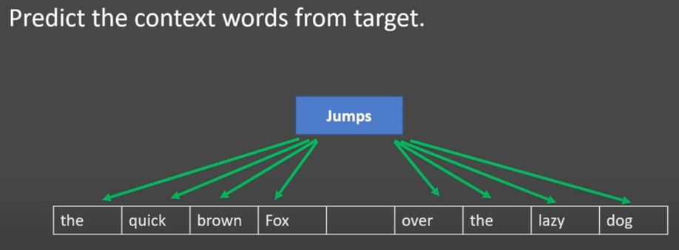
CBOW
Skip-Gram
The CBOW model architecture tries to predict the current target word (the center word) based on the source context words (surrounding words/ window size).
Sampled out ‘99999’ rows from the dataset.
Skip-gram reverses this: it predicts surrounding words from a target word, enabling a deeper understanding of word meanings by considering various context words for each target.
Sampled out ‘99999’ rows from the dataset.

Slide 10
CBOW
Skip-Gram
Since I was dealing with a smaller dataset I achieved higher accuracy on this the CBOW model over the Skip-gram approach, proving the theory that CBOW works better on smaller datasets.
Training Process
Suitable for smaller datasets
Passed the context analysis test.
The Skip-Gram approach took significantly more time than the CBOW approach.
The training objective of the skip-gram model is to maximize the probability of predicting context words given the target word.
Involves performing a full softmax over the entire vocabulary words
Failed the context analysis test.
Involves predicting the target word based on the context words in a window.

Slide 11

3) RESULTS
Building and Evaluating word2vec

Slide 12
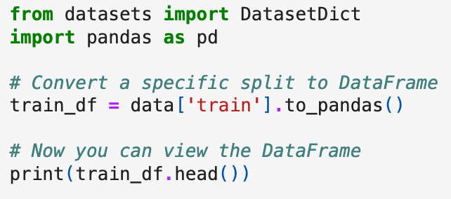
Dataset
I choose the Wikipedia dataset available on huggingface, particularly the English texts.
Which is available in the load_dataset method in Python, with the parameter for the method -> "20220301.en".
Converted the file of datatype - DatasetDict to a pandas df, to sample out the data accurately.

Slide 13
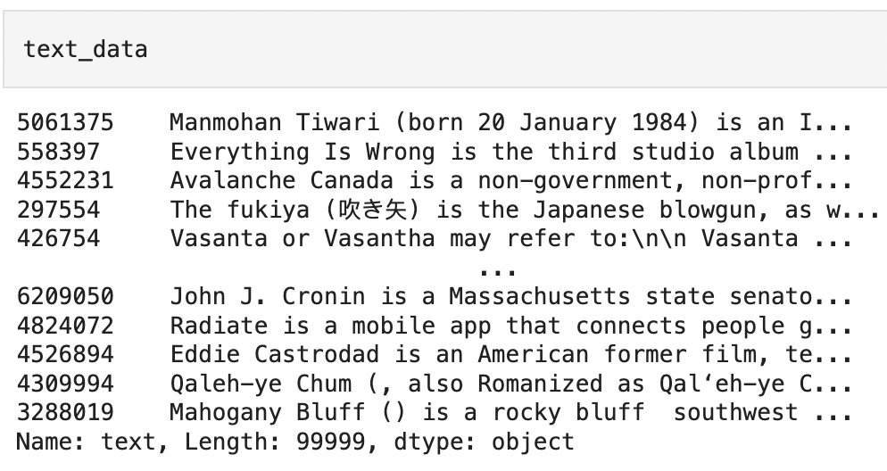
Approach to word2vec
1) Sampling the Data:
Here is the stucture of the Pandas DataFrame

Slide 14
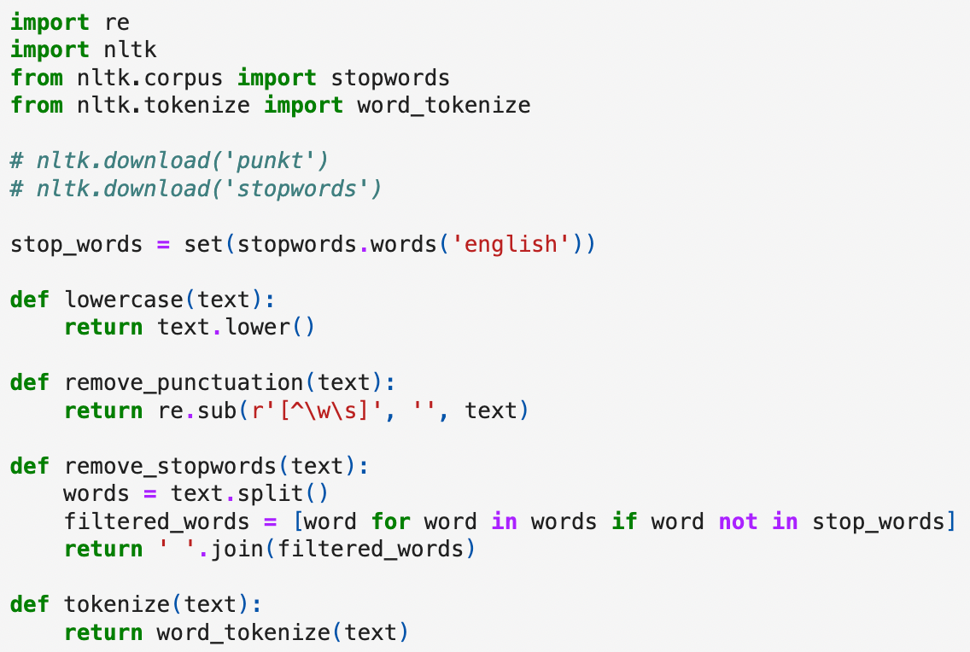
3) Preprocessing
Pre-processing the text, cleaning and preparing it for
Lowercase all text.
Remove Punctuations.
Leaverged Stopwords API from NLTK to remove unnecessary stopwords.
Leaveraged word tokenizer API from NLTK to tokenise the words.

Slide 15
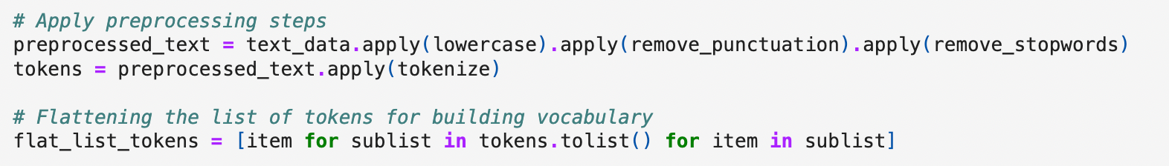

Slide 16
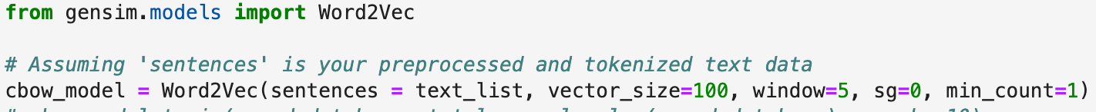
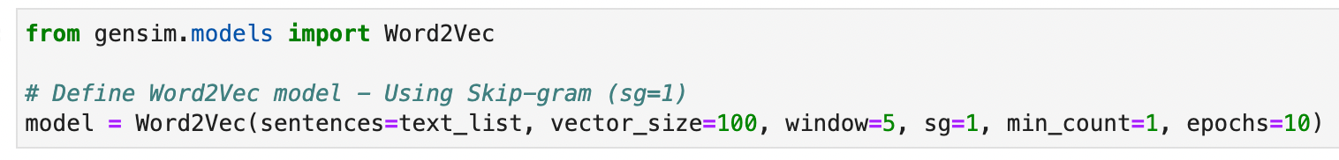
CBOW
Skip Gram

Slide 17

word2vec Evaluation Metrics

Slide 18
Evaluation Metrics:
Introduce evaluation metrics used to assess the quality of word embeddings.
Discuss common metrics like cosine similarity, analogical reasoning tasks, etc.
Present the evaluation results of your trained models.
skip gram
CBOW

Slide 19
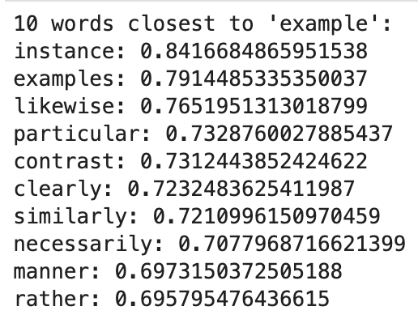
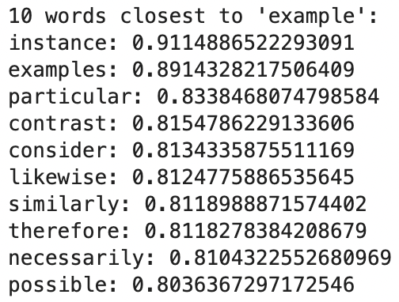
Similarity Test
CBOW
Skip-Gram

Slide 20
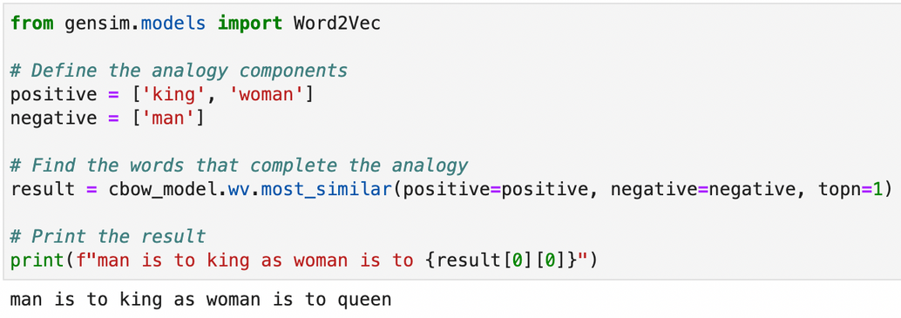
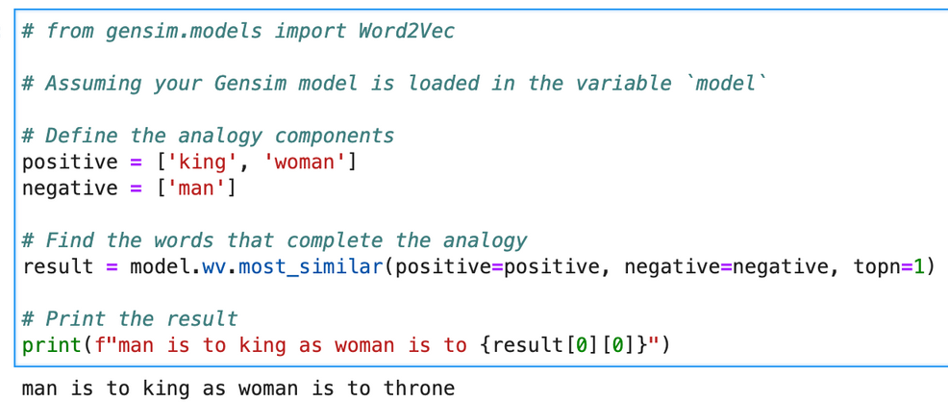
Final - Context Test
CBOW
Skip-Gram

Slide 21
Thank you!

